Slide 1
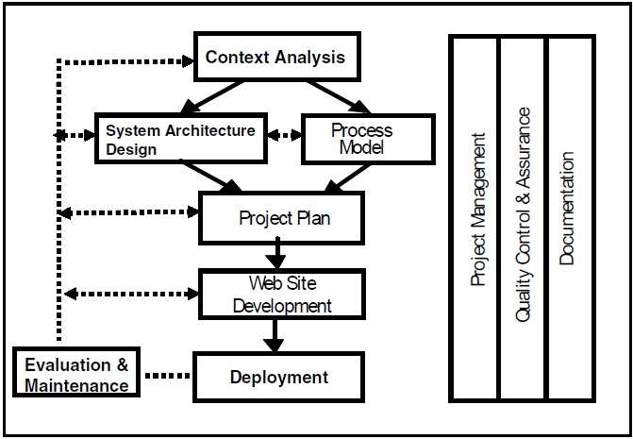
Web development Process

Slide 2
Objectives of context analysis of Web applications
The objectives of context analysis are as given below .
Identify the stakeholders and their broader requirements and experiences.
Identify the functions the Web site needs to provide (immediately, and in the short, medium, and long term).
Establish what information needs to be on the Web site, how to get this information, and how often this information may change.

Slide 3
Objectives of context analysis of Web applications
Identify the corporate requirements in relation to look and feel, performance, security, and governance.
Get a feel of the number of users (typical and peak) and anticipated demands on the system.
Study similar (competitive) Web sites to gain an understanding of their functionalities, strengths, and limitations.

Slide 4
Architecture Design
In system architecture design, we decide on various components of the system and how they are linked. At this stage, we design:
An overall system architecture describing how the network and the various servers(Web servers, application servers and database servers) interact.
An application architecture depicting various information modules and the functions they support.
A software architecture identifying various software and database modules required to implement the application architecture.

Slide 5
Means of fulfilling the requirements of Web application
Requirement | Means of Fulfillment
Uniform look and feel across all Web pages that can easily be modified | Creation of Web pages using templates and style sheets
Consistency of information that may appear in different places or pages | Storing information in a single place (such as in a database or as an XML file), without duplication of information in different places or databases, and retrieving the required information for presentation where and when Needed
Ease of information update and maintenance | Provision of a back-end system to edit information in a data repository; could have Web interface for easy access from anywhere

Slide 6
Requirement | Means of Fulfillment
Ability to add new Web pages easily | Dynamic generation of navigational links, rather than predetermined static navigational links
Decentralized system administration | Provision of a multi-user login system to access back-end systems and inclusion of a “user administration system” that can assign specific functions and data sets to content managers and other developers.

Slide 7
Web Page Design
It determines what information is presented and how it is presented to the users. A prototype usually contains a set of sample pages to evaluate the page layout, presentation, and navigation.
Based on the feedback from the stakeholders, the page design is suitably modified. This process may go through a few iterations until the stakeholders and designers are satisfied with the page layout, presentation and the navigation structure.
Web page content development needs to take into consideration the stakeholders’ requirements, users’ cognitive abilities, technical issues and considerations, nontechnical issues, earlier experiences of developers and users, and lessons learned from similar Web applications.

Slide 8
Web Page Design
If the Web system is intended for global use, by users from different countries, the Web content and presentation may have to be localized; there also may be a need for multilingual Web sites.
Web site’s content and usability have to be designed from a global perspective and be responsive to cultural sensitivity in language along with appropriate use of color,
presentation, and animation

Slide 9
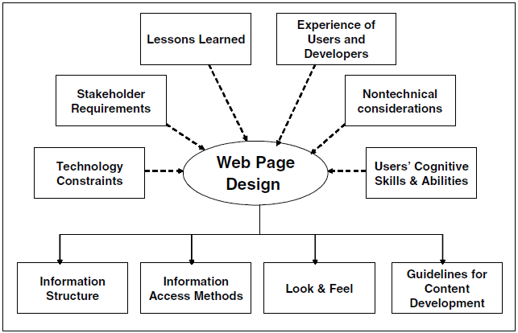
Web Page Design

Slide 10
Web Maintenance
After a Web-based system is developed and deployed online for use, it needs to be maintained. As outlined earlier, content maintenance is a continual process. We need to formulate content maintenance policies and procedures, based on the decision taken at the system architecture design stage on how the information content would be maintained, and then we need to implement them. Further, as the requirements of Web systems grow and evolve, the system needs to be updated and also may be redesigned to cater to the new requirements. It is important to periodically review Web-based systems and applications regarding the currency of information content, potential security risks, performance of the system, and usage patterns (by analyzing Web logs), and take suitable measures to fix the shortcomings and weaknesses.

